Slide 1
Introduction to manuals Information for the proper use of the manuals
RepRapBCN Team

Slide 2
Welcome
If you're holding this book means you're ready to start assembling your BCN3D+ . We hope you will enjoy the experience during the construction process of your printer and also after creating your pieces.
Before you start we going to make a brief introduction to the series of manuals for a even easier experience.

Slide 3
Location of the manuals
In the directory of manuals from the SD card are 8 folders. Each corresponds to a subsystem of the printer and will assemble them in the indicated order.
This way we begin with the structure of the printer, to continue with the elements that allow movement in all three axes (Y, X and Z). With all the mechanics prepared just miss to add the electronics and LCD screen, and finally the wiring.

Slide 4
File types
In each folder you will find 2 types of file with the same name:
*.exe file is an application that offers an interactive guide assembly. You can zoom, move and rotate the view. We recommend this to use because it allows much better understanding of the assembly.
*.pdf file is a sequence of images that correspond to the interactive slides manual. It's equivalent to the above but designed for those users who can not run the application (especially Mac and Linux). Also useful is the .pdf file if you want to assemble the printer with a paper edition of the manual.

Slide 5
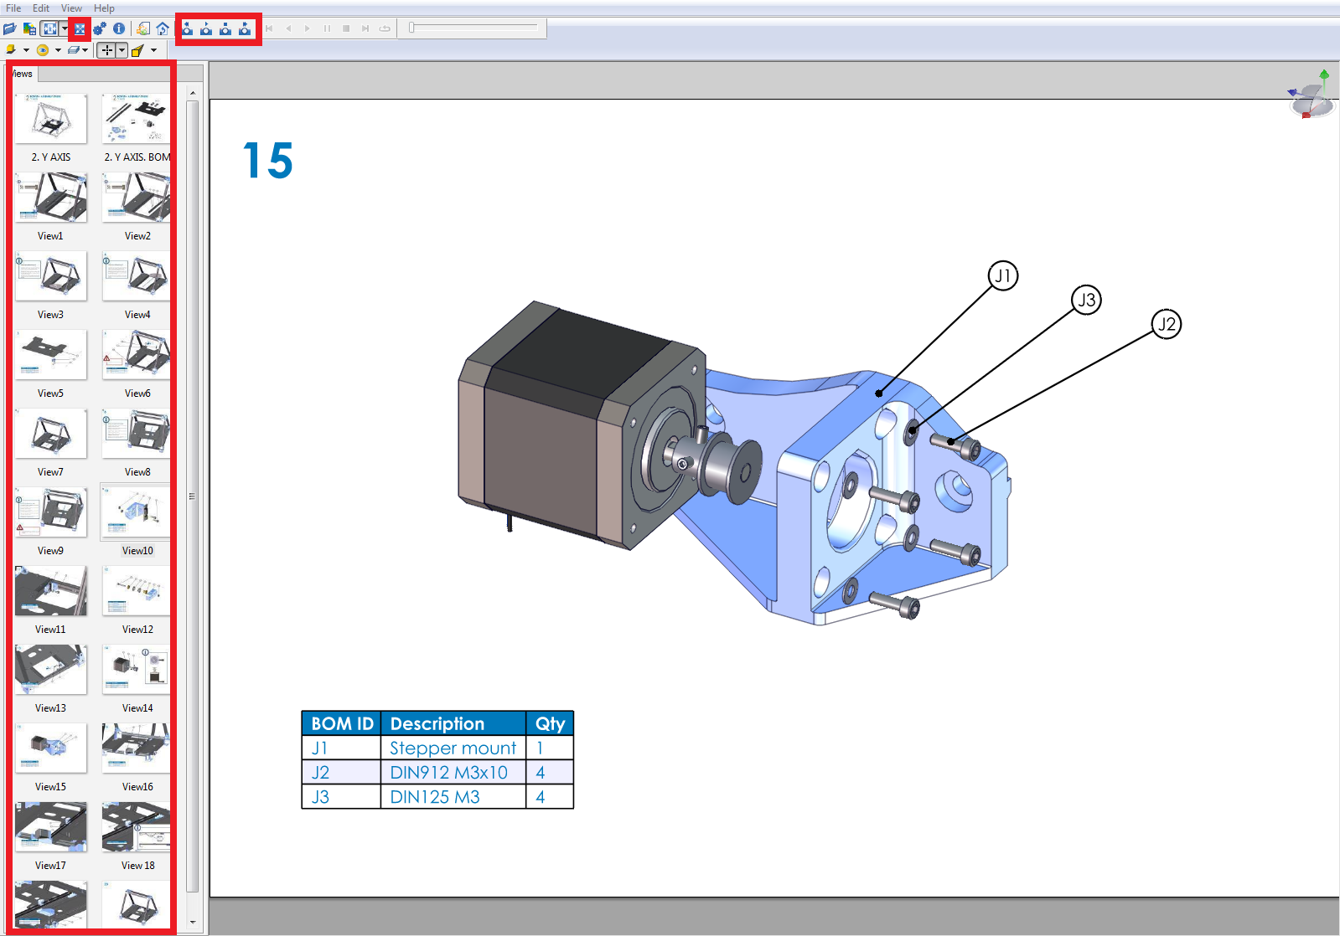
Interactive operation manual
The application of the interactive manual is easy to use, you just need to know the icons to manipulate the views of the 3D printer assembly :

Slide 6
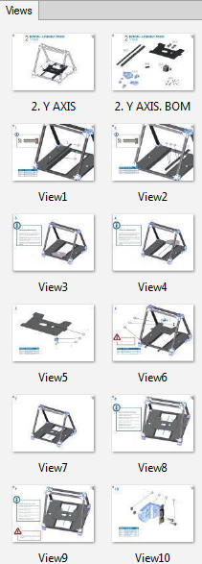
Interactive operation manual: Navigation
Sequential Navigation: To get around the manual you can use the buttons on the top. With them you can go back to a slide, play in auto mode, stop the auto play and go to a slide, in the order they appear.
Sequential Navigation: To get around the manual you can use the buttons on the top. With them you can go back to a slide, advance in auto mode, stop the auto play and go to a slide, in the order they appear.

Slide 7
Interactive operation manual: Navigation
Zoom in / out: By rotating the mouse wheel you can change the zoom and focus on the area you want.
Move: With the same wheel, but using it in button mode you can scroll the image. This way you can move to different parts of the printer without changing the perspective.
Rotate: If you need to get another point of view, you can change the perspective by using the right mouse button, holding it down while you rotate the view.

Slide 8
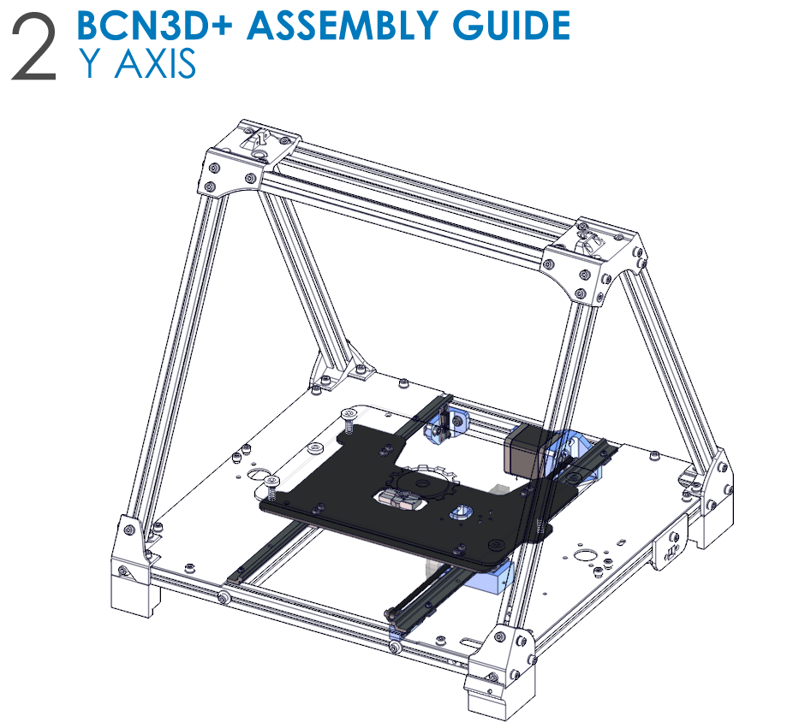
Structure of the chapters
1st Page: Presentation of Chapter
The title of the chapter and the whole machine is displayed on the first slide, with the silhouette of the pieces you have assembled so far and in color which have to be installed in this chapter.

Slide 9
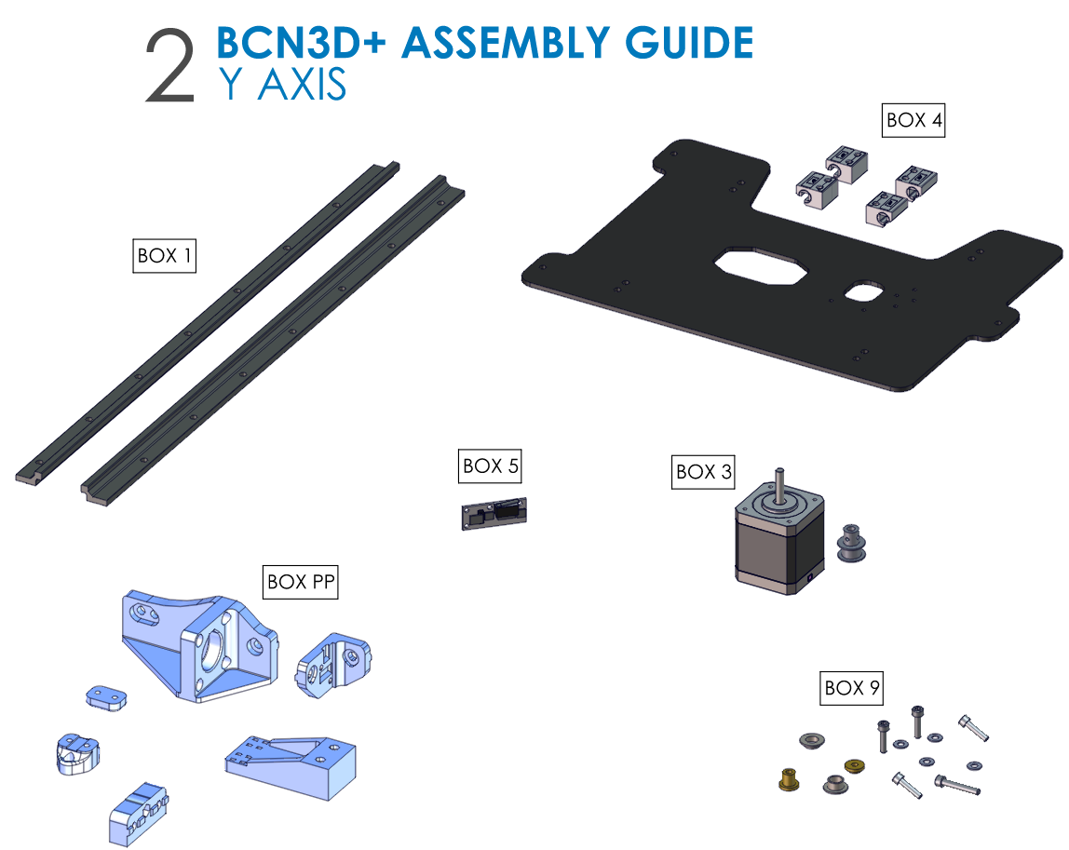
Structure of the chapters
2nd page: parts distribution in boxes
The second page is a summary of the parts to be used in this chapter, grouped by type of part, to identify where you have to look for each one.
It is important to remember that NOT all parts are listed only the main ones, is just to know in which boxes are the necessary equipment.

Slide 10
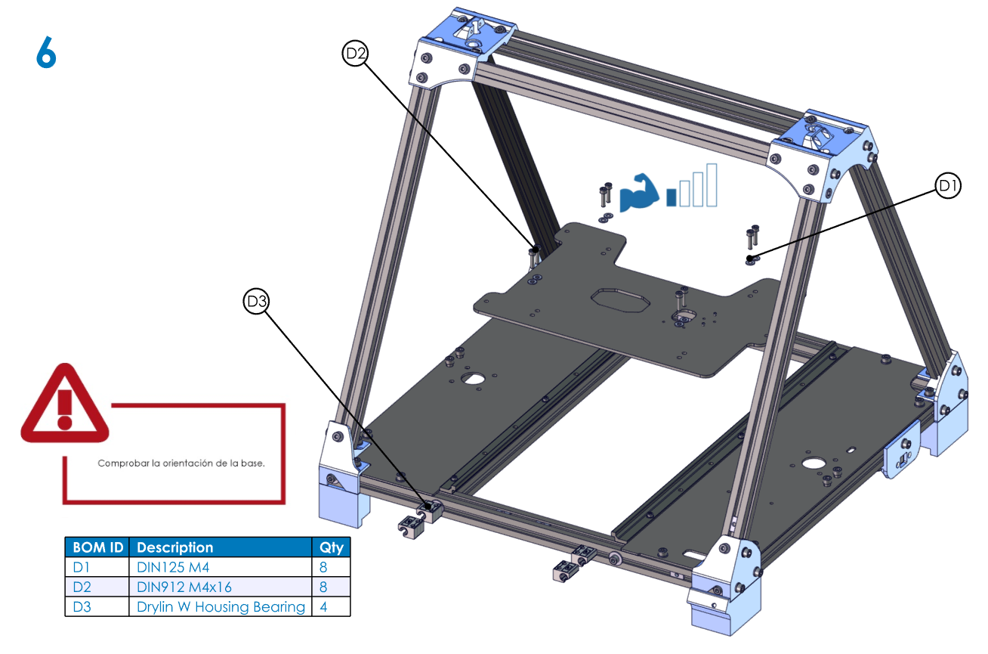
Structure of the chapters
Other pages: Installation steps
Each of the steps shown in a slide type that has common elements: slide number, steps to follow, list of components, callouts and annotations component ID number (only when necessary).

Slide 11
Structure of the chapters
Common elements
Slide Number: Located in the top left, and helps identify the step that is being processing.
Steps to perform: Figure of the machine tells you the components to be mounted on that step. When you change the slide, the components are moved to the mounting position. Back and forth you can get a better idea of ​​how to mount the component, and you can repeat this step as many times as you needed.

Slide 12
Structure of the chapters
Common elements
List of components: The table is usually found on the bottom left (although sometimes may appear elsewhere) indicates the components that you need in that step. The first column is the ID part of the manual, the second is the name and the third the quantity. We recommend to prepare all the parts of the table before you start assembling the step.
The callouts component indicator: Indicator used to easily identify the parts to be assembled in 3D view. The callouts still appears even rotate the 3D view and if necessary, you can move to have a clearer view and to avoid crossing the image. Just click on the callouts itself and without releasing the mouse button, drag it to the desired position.

Slide 13
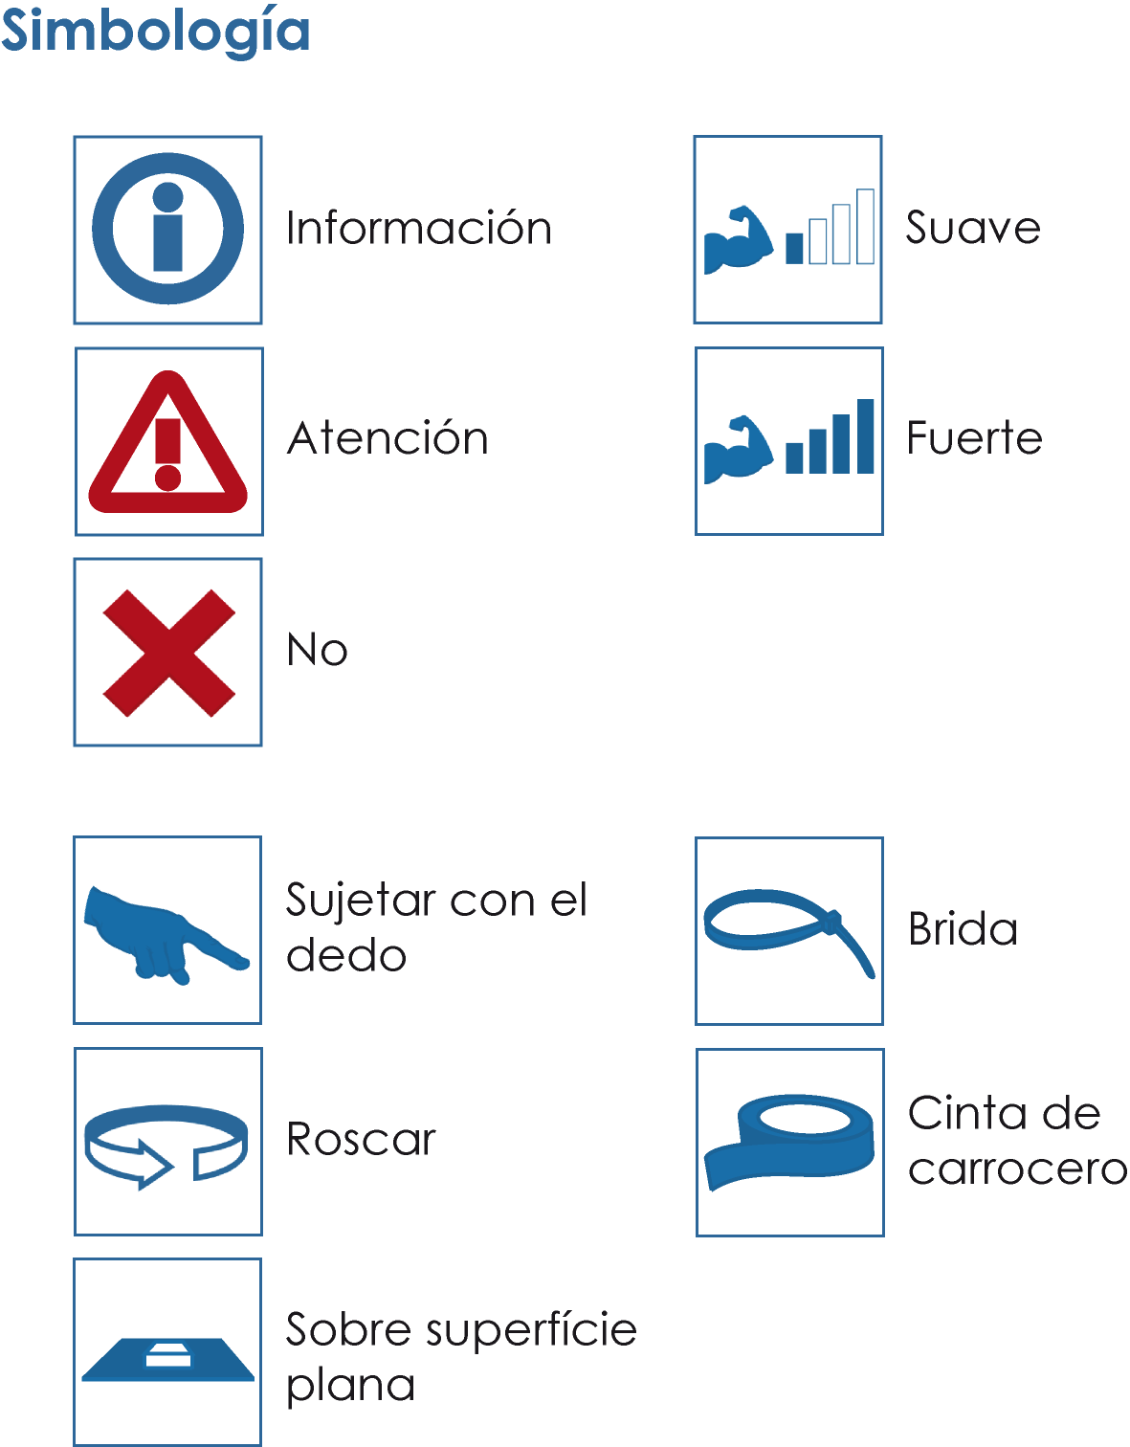
Structure of the chapters
Notes: In the slides that require it, a series of annotations. Each symbol corresponds to the message that is described below:
INFORMATION: Always accompanied by an explanatory note that is not essential for the assembly of the printer but is useful to facilitate understanding of the manual.
CAUTION: This icon is always accompanied by an essential explanatory annotation for the correct assembly of the printer.
NOT: Indicates something that should not be as in the picture. It also used to help distinguish between components to be used.

Slide 14
Structure of the chapters
TIGHTEN WITH FINGER: Indicates something that should hold it by hand until it locks in a definitive way.
THREAD: Indicates the component that affects must be threaded.
FLAT SURFACE: Indicates that the operation referred to must be performed on a flat surface. Affects critical parts of the structure and serves to ensure a good reference planes for other mechanisms.
FLANGE CLOSE: This icon indicates that the corresponding step needs to close one or more flanges at the indicated position.

Slide 15
Structure of the chapters
SOFT TIGHTEN: Indicates that this torque should be smooth, simply to ensure that the screw is attached to the component without deforming. It usually affects plastic components that can break under excessive force.
TIGHTEN STRONG: Indicates that this torque must be strong to ensure that the component is properly fixed. It usually affects metallic components that transmit important efforts under operation.
FLAT SURFACE: Indicates that the operation referred to must be performed on a flat surface. Affects critical parts of the structure and serves to ensure a good reference planes for the mechanisms.
TAPE: Indicates to use adhesive (or similar) tape during the step to temporarily hold some component.

Slide 16
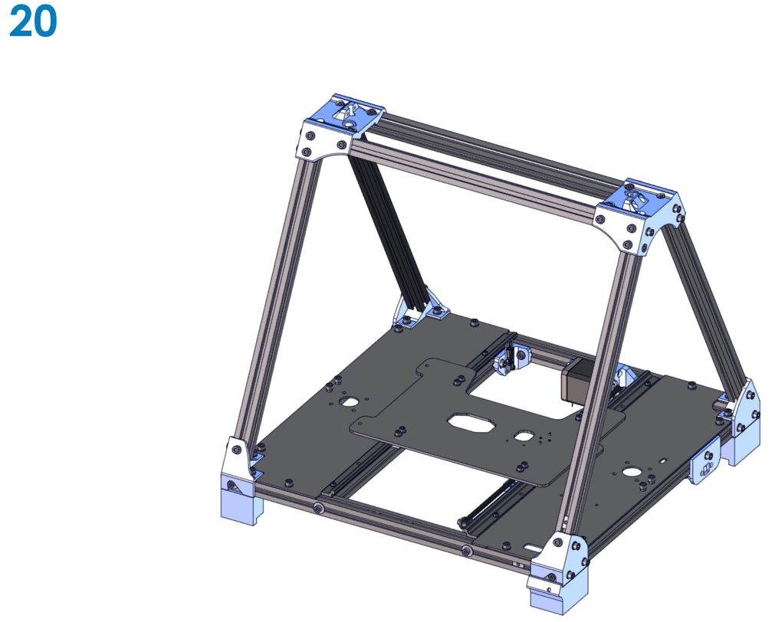
Structure of the chapters
Last Page: End of Chapter
The last page of each chapter shows the final step of the assembly procedure.

Slide 17
We hope you enjoy the experience! Do not forget to follow us on Twitter and Facebook For any questions visit our forum!
RepRapBCN Team

